Slide 1
Unit 2 ,4
8086 Microprocessor

Slide 2
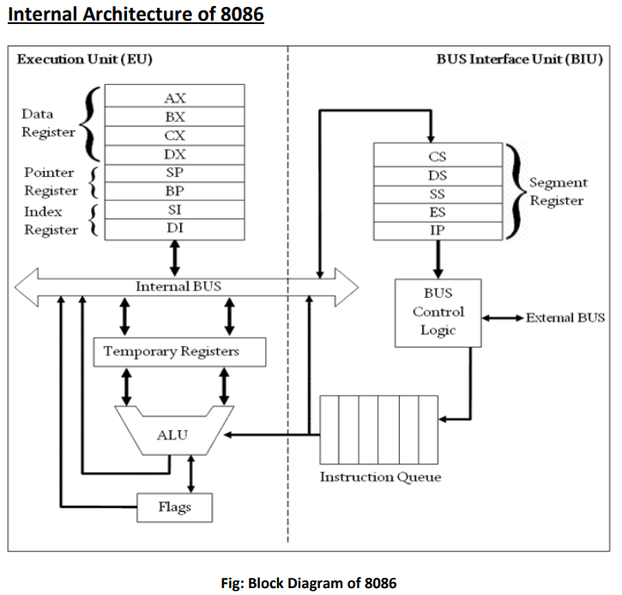
8086 microprocess :Architecture

Slide 3
Internal architecture of 8086
8086 contains two independent functional units: Bus Interface Unit (BIU) and Execution Unit (EU).
Bus Interface Unit (BIU)
The segment registers, instruction pointer and 6-byte instruction queue are associated with the bus interface unit (BIU).
• The BIU:
Handles transfer of data and addresses,
Fetches instruction codes, stores fetched instruction codes in first-in-first-out register set called a queue,
Reads and writes data from memory and I/O devices,
• It has the following functional parts:
Instruction Queue: When EU executes instructions, the BIU gets 6-bytes of the next instruction and stores them in the instruction queue and this process is known as instruction pre fetch. This process increases the speed of the processor.
Segment Registers: A segment register contains the addresses of instructions and data in memory which are used by the processor to access memory locations.
Instruction Pointer (IP): The instruction pointer in the 8086 microprocessor acts as a program counter. It indicates to the address of the next instruction to be executed.

Slide 4
Internal architecture of 8086
Memory segmentation
To increase the execution speed and fetching speed, 8086 segments the memory.
It has 20 bit address bus can address 1 MB of memory, it segments it into 4 64 kB segments.
8086 works only with four 64KB segments within whole 1MB memory.
There are 4 segment registers in 8086. They are:
Code Segment Register(CS)
Data Segment Register(DS)
Stack Segment Register (SS)
Extra Segment Register (ES)

Slide 5
Classification of register (Based on 8086 microprocessor)
Segment register: A segment register points to the starting address of the particular memory segment. Types of segment register:
Code segment: It contains all the instructions to be executed. The instruction codes resides on the code segments. It points to the starting address of the code segment.
Data segment: local data, variables and constant resides in the data segments. It indicates the starting address of the data segment.
Stack segment: The stack segment register stores the starting address of the stack.
Extra segment: External(global) data reside in extra segment. It holds the destination addresses of some data of certain string insturctions.

Slide 6
8086 Microprocessor Architecture
Execution Unit (EU)
The EU receives opcode of an instruction from the queue, decodes it and then executes it.
While Execution unit decodes or executes an instruction, then the BIU fetches instruction codes from the memory and stores them in the queue.
It consist of following registers:
General purpose registers
Index register
ALU
Flag register

Slide 7
Classification of register (Based on 8086 microprocessor)
General purpose register
General-purpose registers can be used for multiple purposes and assigned to a variety of functions by the programmer. It is user visible register. In 8086 microprocessor. The registers AX, BX, CX, and DX are the general 16-bit registers.
AX Register: Accumulator register consists of two 8-bit registers AL and AH, which can be combined together and used as a 16- bit register AX. AL in this case contains the low-order byte of the word, and AH contains the high-order byte. Accumulator can be used for I/O operations, rotate and string manipulation. It is most efficient in data movement, arithmetic and logical operation. Its function depends on the design of the processor whether the processor is an accumulator based processor or general purpose registers based processor. After the execution of arithmetic and logical instruction the result is placed in the accumulator. All data transfer between CPU and device/port are performed through the accumulator.

Slide 8
Classification of register (Based on 8086 microprocessor)
General purpose register
BX Register: This register is mainly used as a base register. It holds the starting base location of a memory region within a data segment. It is used as offset storage for forming physical address in case of certain addressing mode.
CX Register: It is used as default counter or count register in case of string and loop instructions.
DX Register: Data register can be used as a port number in I/O operations and implicit operand or destination in case of few instructions. Some I/O instruction move data between and identified I/O port and the memory location address by register DX.

Slide 9
Classification of register (Based on 8086 microprocessor)
Pointer and index register
Stack pointer (SP): The stack is a sequence of memory location defined by the user. It is used to save the contents of a register if it is required during the execution of a program. The stack pointer holds the address of the last occupied memory location of the stack. Thus indicates upto what memory location the stack is already filled up.The PUSH instruction is used to transfer the content of the register to the stack and the POP instruction to bring back content from the stack to the register.
Base Pointer (BP): Its helps in referencing the parameter variables passed to a subroutine. The address in SS register is combined with the offset in BP to get the location of the parameter. BP can also be combined with DI and SI as base register for special addressing.
Source Index (SI): It is used as source index for string operation.
Destination Index (DI): It is used as a destination index for string operation.

Slide 10
Classification of register (Based on 8086 microprocessor)
Special purpose register
CPU contains a number of special purpose registers for different purposes.
Instruction Pointer: It act as a program counter used to point to the next instruction to be executed. So, it holds the address of the memory location which contains the next instruction to be fetched from the memory. Its content is automatically incremented after an instruction has been fetched assuming that instructions are normally executed sequentially. In case of a jump instruction its contents are modified and program jump to the memory location which contains the desired instruction to be executed next. The processor which use data flow architecture do not contain PC. The content of code segment register is added to the content of the IP to compute the address of the next instruction.

Slide 11
Classification of register (Based on 8086 microprocessor)
Special purpose register
Stack pointer: The stack is a sequence of memory location defined by the user. It is used to save the contents of a register if it is required during the execution of a program. The stack pointer holds the address of the last occupied memory location of the stack. Thus indicates upto what memory location the stack is already filled up.

Slide 12
Classification of register (Based on 8086 microprocessor)
8086 microprocessor contains the following condition flags:
Carry flag (CY): It indicates whether there is carry or not after an arithmetic or logical operation. If some operations are generating carry after the operation this flag is set 1.
Zero flag(Z): It indicate whether the result of arithmetic or logical operation is zero or non-zero.
Sign flag(S): It indicate whether the result is –ve or +ve.
Parity flag(P): It indicate whether the result contains odd number of 1’s or even number of 1’s.
Axuillary carry(AC): It is also known as half carry. When some arithmetic operation generates carry after the lower half and send it to upper half the AC will be 1.
Overflow Flag (O): The overflow flag is set to 1 when the result of signed operation is too large to fit in the number bits available to represent it.

Slide 13
Classification of register (Based on 8086 microprocessor)
Status Flag: The 8086 has 16 bit status register. It has 9 status flags.
8086 microprocessor contains the following control flags:
Directional flag(D): This is used in string related operation. If D=1, then the string will be accessed from higher memory address to lower memory address, and if D=0, it will do the reverse i.e. When it is 1 index register SI and DI are decremented resulting in the access of string from the highest memory address down the lowest memory address. If the direction status is 0, the index register SI and DI are incremented resulting in the access of strings from the lowest memory address.
Interrupt flag (I): If I=1, then MPU will recognize the interrupt from peripherals. If I=0, the interrupt will be ignored.
Trap flag(T): It is used for on chip debugging. When T=1, the CPU automatically generates an internal interrupt after each instruction, allowing a program to be inspected as it executes instruction by instruction. If trap is reset to 0 no function is performed.

Slide 14
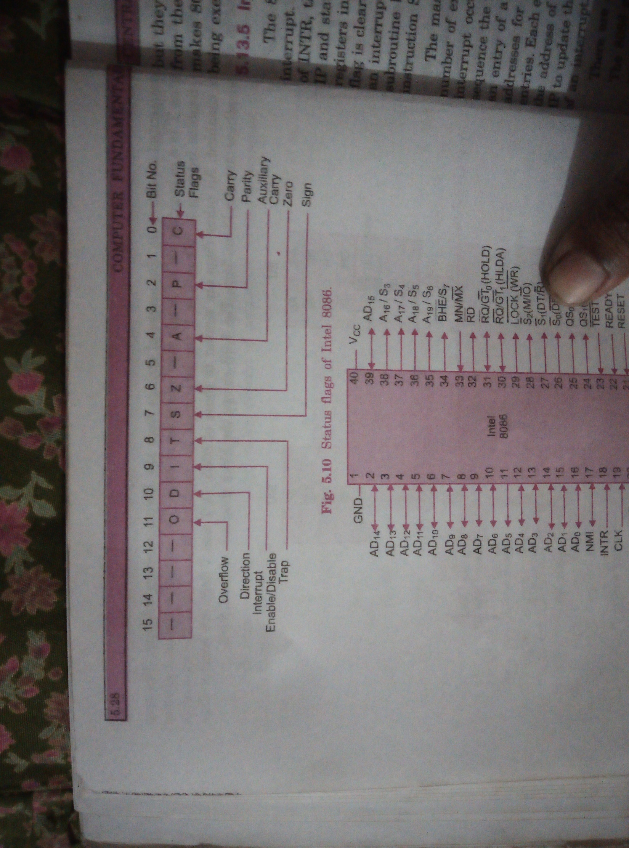
Classification of register (Based on 8086 microprocessor)

Slide 15
8086 Instruction sets
An instruction is a binary pattern designed inside a microprocessor to perform a specific function.
The entire group of instruction that a microprocessor supports is called instruction set. 8086has more than 20000 instructions.
We can categorize instruction sets into following types:
Data transfer instructions
Arithmetic instructions
Bit manipulation instructions
Program execution transfer instructions
String instructions
Process control instructions.

Slide 16
8086 Instruction sets: Data transfer instructions
These instructions are used to transfer data from source to destination.
The operand can be a constant, memory location, register or I/O port address.
We can transfer data from one register to another, register to memory, memory to register but transferring data from memory to memory is illegal.
Some of the instructions used for data transfer are: mov, push, pop, xchg, in, lea, lds, etc.
MOV Des, Src:
Src operand can be register, memory location or immediate operand whereas Des can be register or memory operand. Both Src and Des cannot be memory location at the same time.
MOV CX, 037AH
MOV AL, BL
MOV BX, [0301h]

Slide 17
8086 Instruction sets: Data transfer instructions
PUSH and POP:
PUSH help to move operand into top of stack
POP helps to remove the operand from top of stack and place it in Des. Des can be general purpose register, segment register or memory location.
Example: PUSH BX
POP AX
XCHG:
This instruction exchanges Src with Des. It cannot be possible to exchange two memory locations directly.
Example: XCHG DX, AX
IN
It transfer the oprand from specified port to accumulator register.
Example: IN AX, 0028H
Out
It transfer the operand from accumulator to specified port.

Slide 18
8086 Instruction sets: Data transfer instructions
LEA
It loads a16 bit register with the offset address of the data specified by the src.
Example: LEA BX, [DI]
This instruction loads the contents of DI (offset) into BX register.

Slide 19
8086 Instruction sets: Arithmetic Instructions
ADD
It adds a byte to byte or word to word. It effects AF, CF, OF, PF, SF, ZF flags.
Add AL, 74H
ADD DX, AX
ADD AX, [BX]
ADC
It adds two operands with CF. It effects AF, CF, OF, PF, SF, ZF flags.
ADC AL, 74h
ADC DX, AX
ADC AX, [BX]
SUB
It subtracts a byte from byte or word from word. It effects AF, CF, OF, PF, SF, ZF flags. For subtraction CF, acts as borrow flag.

Slide 20
8086 Instruction sets: Arithmetic Instructions
INC
It increments the byte or word by one. The operand can be a register or memory location.
It effects AF, OF, PF, SF, ZF flags. CF cannot be affected.
DEC
It decrements the byte or word by one. The operand can be a register or memory location.
It effects AF, OF, PF, SF, ZF flags. CF cannot be affected.
AAA (ASCII Adjust After Addition)
The data entered from terminal is in ASCII format. In ASCII 0-9 are represented by 30H-39H. This instruction allows us to add the ASCII codes. This instruction doesnot have any operand.
Other ASCII instructions are: AAS (ASCII adjust after subtraction), AAM (ASCII adjust after multiplication), AAD (ASCII adjust before devision).

Slide 21
8086 Instruction sets: Arithmetic Instructions
NEG :
IT creates 2’s complement of a given number. That means it changes the sign of a number.
CMP
It compares two specified bytes or words. The src and des can be a constant, register or memory location. Both operands cannot be memory location. The comparison is done simply by internally subtracting the source from destination. The value of source and destination doesnot change but the flags are modified to indicate the result.
MUL
It is an unsigned multiplication instruction. It multiplies two bytes to produce a word or two words to produce a double word. IMUL is a signed multiplication instruction.

Slide 22
8086 Instruction sets: Arithmetic Instructions
DIV
It is an unsigned division instruction. It divides word by byte or double word by word. The operand is stored in AX. The result is stored as:
AH=remainder AL=Quotient
IDIV is a signed division instruction.
CBW
This instruction converts bytes in AL to word in AX. This conversion is done by extending the sign bit of AL through out AH.

Slide 23
8086 Instruction sets: Bit manipulation
These instructions are used at bit level. These instructions are used for shifting bits, testing a zero bit or changing a bit value. Instructions used for bit manipulation are: NOT, AND, OR, XOR, SHL, ROL, ROR, etc.
NOT
It complements each bit of Src to produce 1’s complement of specified operand. The operand can be a register or memory location.
AND
It performs AND operation of Des and Src.
Src can be immediate number, register or memory location. Des can be register or memory location.
Both operands cannot be memory location at the same time. CF and OF become zero after the operation. PF, SF, ZF are updated.

Slide 24
8086 Instruction sets: Bit manipulation
OR
It performss OR operation of Des and Src. Src can be immediate number, register or memory location. Des can be register or memory location. Both operands cannot be memory locations at the same time. CF and OF becomes zero after the operation whereas PF, SF, ZF are updated.
XOR
It performs XOR operation of Des and Src. Src can be immediate number, register or memory location. Des can be register or memory location. Both operands cannot be memory locations at the same time. CF and OF becomes zero after the operation whereas PF, SF, ZF are updated.
SHL
It shift bits of byte or word left by count. It puts zero(s) in LSBs, MSB is shifted into carry flag. If the number of bits desired to be shifted is 1 then immediate number 1 can be written in Count. But if the number of bits to be shifted is more than 1 then count is put in CL register.
Example: shl bx, 5

Slide 25
8086 Instruction sets: Bit manipulation
SHR
It shift bits of byte or word right by count. It puts zero(s) in MSB, LSB is shifted into carry flag. If the number of bits desired to be shifted is 1 then immediate number 1 can be written in Count. But if the number of bits to be shifted is more than 1 then count is put in CL register.
Example: sh bx, 5
SAR
It stands for Shift Arithmetic Right. It shifts the mentioned bits in registered in to right side one by one but instead of inserting zeros from left end, MSB is restored. The rightmost bit that is being shifted is stored in carry flag (CF).
SAL
It stands for Shfit Arithmetic Left. It shifts the mentioned bits in registered into left side one by one.
Other bit manipulation instructions are: ROR,, ROL, RCL, RCR, etc

Slide 26
8086 Instruction sets: Program Execution Transfer Instructions
These instructions cause changein sequence of the execution of instruction. This change can be through a condition or sometimes unconditional. The conditions are represented by flags. Some of the program execution instructions are call, ret, jmp, ja, jae, je, jnc, jne, jnz, jpe, jz, etc.
Call
This instruction is used to call a subroutine or function or procedure. The address of next instruction after call is saved into stack.
Ret
It returns the control from procedure to calling program. Every call instructions should have a RET.
JMP
This instruction is used for unconditional jump from one place to another.

Slide 27
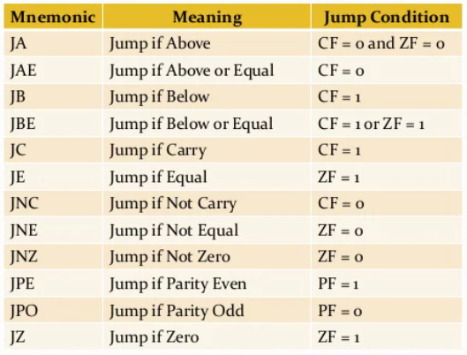
8086 Instruction sets: Program Execution Transfer Instructions
Jxx (conditional jump)
All the conditional jumps follows some conditional statement or any instruction that affects the flag.

Slide 28
8086 Instruction sets: Program Execution Transfer Instructions
Loop
This is a looping instruction. The number of times looping is required is placed in the CX register. With each iteration, the content of CX are incremented. ZF is checked whether to loop again or not.

Slide 29
8086 Instruction sets: String instructions
String in assembly language is just a sequentially stored bytes or words.
There are very strong set of string instructions in 8086 by the use of which the size of program is considerably reduced. Some of the instructions are : cmps, scas, movs, movsb, movsw, rep, etc.

Slide 30
8086 Addressing Mode
Addressing mode is the way the operand is given in an instruction.
In 8086 there are 11 different addressing mode. They are:
Register Addressing mode
Direct Addressing mode
Immediate addressing mode
Implied/Implicit Addressing mode
Register Indirect addressing mode
Based Indexed addressing mode
Indexed addressing mode
Based addressing mode
Based indexed displacement addressing mode
Relative addressing mode
I/O mode

Slide 31
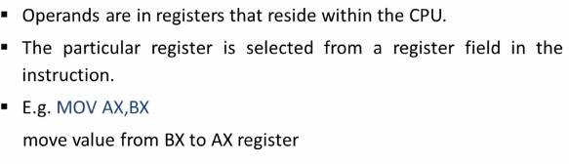
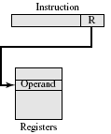
8086 Addressing Mode
Register Addressing mode

Slide 32
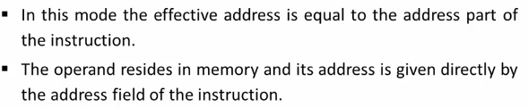
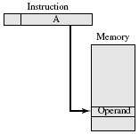
8086 Addressing Mode
2. Direct Addressing mode
Example:
mov bx,[4050h]

Slide 33
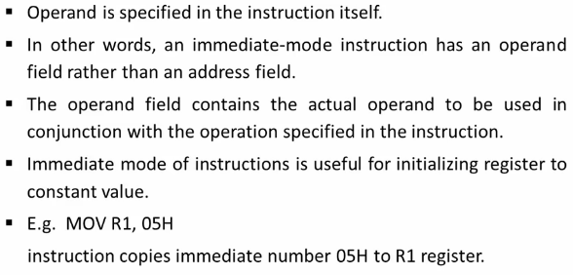
8086 Addressing Mode
3. Immediate addressing mode
The advantage of immediate addressing is that no memory reference other than the instruction fetch is required to obtain the operand thus saving one memory or cache cycle in the instruction cycle. However size of the number is restricted to the size of the address field which is small compared to word length.

Slide 34
8086 Addressing Mode
3. Implied/Implicit Addressing mode
Operands are specified implicitly in the definition of the instruction.
For example CLC (clear carry flag) instruction is an implied instruction as the operand in the acccumulator register is implied in the definition of the instruction.

Slide 35
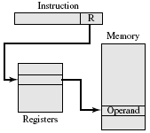
8086 Addressing Mode
Register Indirect addressing mode: In this addressing mode the effective address in SI, DI or BX register. The name of the register which holds the effective address (EA) will be specified in the instruction. Example:
Mov Ax,[DI]
mov AL,[BX]
mov AX,[SI]

Slide 36
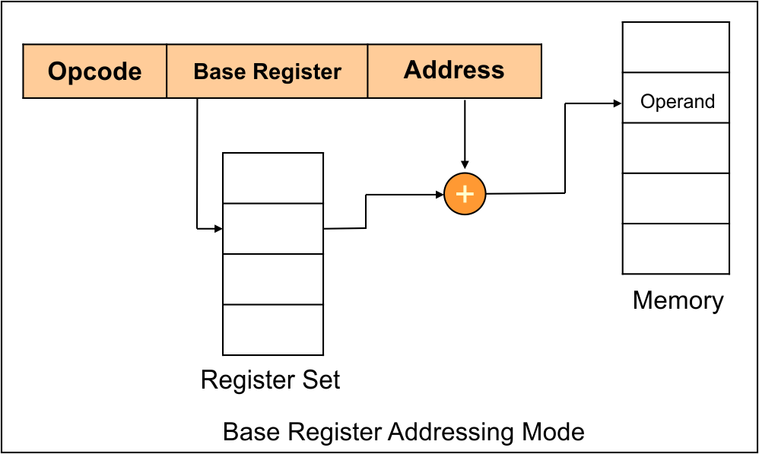
8086 Addressing Mode
Based addressing mode: In this type of addressing mode, BX or BP is used to hold base value for EA and a signed 8 bit or unsigned 16 bit displacement will be specified in the instruction. The effective address is sum of base register and displacement.
When BX holds the base value of EA 20 bit physical address is calculated from BX and DS.
When BP holds base value of EA, BP and SS is used. Example:
mov ax,[BP+2000]
mov al,[BP+3000]

Slide 37
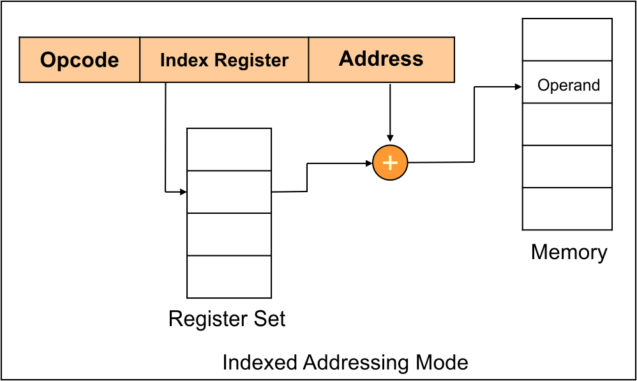
8086 Addressing Mode
Indexed addressing mode
In this type of addressing mode the effective address is sum of index register and displacement. Example:
mov ax,[si+1000]
mov al,[di+3000]

Slide 38
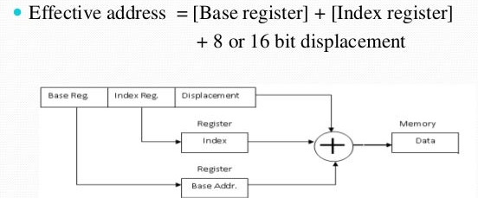
8086 Addressing Mode
Based indexed displacement addressing mode
In this type of addressing mode the effective address is the sum of index register (SI or DI), base register (BP or BX) and displacement. Example:
mov AL,[Si+BP+2000]

Slide 39
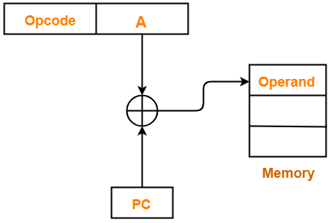
8086 Addressing Mode
Relative addressing mode
In this effective address is calculated with reference to Instruction pointer by an 8 bit displacement.
Example: JZ 0AH
EA=address part of instruction + Content of Instruction Pointer

Slide 40
8086 Addressing Mode
I/O mode
The addressing mode related with I/O operations. These addressing mode are used to access data from standard I/O mapped devices or ports.
In direct port addressing mode, an 8 bit port address is directly specified in the instruction.
Example: IN AL,[09h]

Slide 41
int 21h
INT 21h is the assembly language mnemonic for the Intel CPU command used to perform a System call to the operating system MS-DOS.
MS-DOS actually used quite a few different software interrupt vectors for system calls, but INT 21h was the main one.
Function number Description
01h:
e.g. mov ah,01h
int 21h
Keyboard input with echo: This operation accepts a character from the keyboard buffer.
If none is present, waits for keyboard entry.
It returns the character in AL.
02h
e.g. mov ah,02h
int 21h
Display character: Send the character in DL to the standard output device console.

Slide 42
int 21h
Function number Description
09h :
e.g. mov ah,09h
int 21h
String output: Send a string of characters to the standard output. DX contains the offset address of string. The string must be terminated with a ‘$’ sign.
0Ah
String input
4Ch
e.g. mov ax,4Ch
int 21h
Terminate the current program

Slide 43
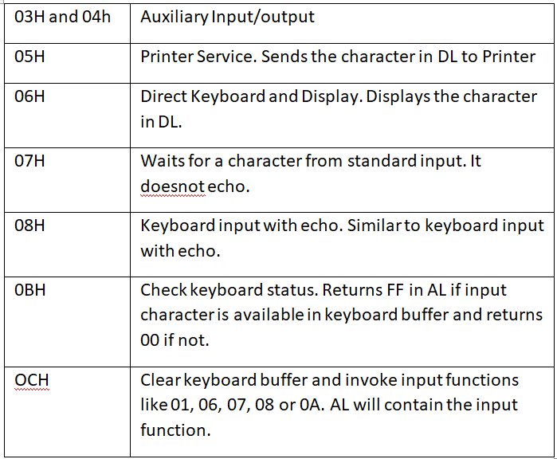
int 21h
Function number Description: Others

Slide 44
int 10h
INT 10H functions is a video display vector interrupt used for Video display services (BIOS services).
It controls the screen format, color, text style, making windows, scrolling, etc.
Function number Description
00h Set video mode
01h Set cursor size
02h Set cursor position
06h Scroll window up
07h Scroll window down
08h Read character and attribute of cursor
09h Display character and attribute at cursor
0Ah Display character at cursor

Slide 45
Datatype in 8086
DB : It stands for Define Byte. The size of this is 1 byte. It can range from -128 to 127 for signed. For unsigned, it ranges from 0 to 255.
DW: It stands for Define Word. The size of this is 2 byte. It can range from -32768 to 32767 for signed type. For unsigned, it ranges from 0 to 65535.
DD: It stands for Define Double. The size of this is 4 byte. I can ranges from -2,147,483,648 to 2,147,483,647 for signed type. For unsigned, it ranges from 0 to 4,294,967,295.
DQ: It stands for Define Quad. The size of this is 8 bytes. It ranges from -2⁶³ to 2⁶³-1 for signed type. For unsigned, it ranges from 0 to 2⁶⁴-1.
Now, the variable declaration and initialization:
Variable_name data_type value
Example:
Age db 15
Msg db “Hello$”
character db ‘a’
a db ? ;for unsigned

Slide 46
Datatype in 8086
Signed numbers: Negative numbers
a db -2 ;this is treated as signed numbers
Signed numbers are represented by the two’s complement value of that number.
Unsigned Numbers: Positive numbers.
a db 2 ; this is treated as unsigned numbers
We can also determine if the number is positive or negative by the MSB (Most Significant bit). If it is 1 then the number is negative number. If it is 0 then number is positive number.

Slide 47
Assembler directives
An assembler directive is a message to the assembler that tells the assembler something it needs to know in order to carry out the assembly process.
It provides information to the assembler regarding the name of the program or data segment for that particular segment.
This is used to set the program or register address during assembly.
For example, ORG 0100h tells the assembler to assemble all subsequent code starting at address 0100h.
Some of the assembler directives are:
DB directive
DW directive
DD directive
STRUCT (or STRUC) and ENDS directives
EQU Directives
The Comment directive
ASSUME
EXTERN
GOBAL
SEGMENT
OFFSET
PROC
GROUP
INCLUDE

Slide 48
Assembler directives
STRUCT (or STRUC) and ENDS directives:
Define the structure template for grouping data items.
The STRUCT directive tells the assembler that a user defined uninitialized data structure follows.
The uninitialized data structure consists of a combination of the three supported data types: DB, DW, and DD.
The labels serve as zero-based offsets into the structure. The first element’s offset for any structure is 0. A structure element is referenced with the base “+” operator before the element’s name. Example:
STRUCT
Byte1 DB ?
Word1 DW ?
Dword1 DW ?
ENDS

Slide 49
Assembler directives
EQU Directives
It is used to give name to some value or symbol. Each time the assembler finds the given names in the program.
It will replace the name with the value or a symbol. The value can be in the range 0 through 65535.
Example:
.data
a db ? ;here a is variable name
b equ a ;here b is not a variable it is just a synonym for a.

Slide 50
Assembler directives
Segment
It is used to indicate the start of a logical segment. It is the name given to the segment. Example: the code segment is used to indicate to the assembler the start of logical segment.
Proc (Procedure)
It is used to identify the start of a procedure. It follows a name we give the procedure.
NAME
It is used to give a specific name to each assembly module when program consists of several modules.
INCLUDE
It is used to tell the assembler to insert a block of source code from the named file into the current source module. This shortens the source module.

Slide 51
Assembler directives
OFFSET
It is an operator which tells the assembler to determine the offset or displacement of a named data item from the start of the segment which contains it.
It is used to load the offset of a variable into a register so that variable can be accessed with one of the addressed modes.
GROUP
It can be used to tell the assembler to group the logical segments named after the directive into one logical group.
This allows the contents of all he segments to be accessed from the same group.

Slide 52
Near and far pointer
Near pointer is used to store 16 bit addresses means within current segment.
Therefore all procedures and variables are within current code and data segments.
The limitation is that we can only access 64KB of code and data at a time.
Far pointer is typically 32 bit that can access memory outside the current segment.
Therefore, all procedures and variables are outside the code and data segment.

Slide 53
Memory model definition
The memory model specifies the memory size assigned to each of the different parts or segments of a program.
There are six memory model. They are:
Tiny: All data, code and stack segment must fit in one physical segment of size <=64K i.e 1 physical segment (Code+data<=64KB). Therefore all prodecures and variables are by default addressed as NEAR by pointing at their offsets in the segment.
Small: One code segment of size <=64K, One data segment of size <=64K. In this model, all procedures and variables are addressed as NEAR by pointing to their offsets only.
Medium: The size of code segment can be more than 64KB and data segment is less 64KB. In this data elements are treated as NEAR and code elements are addressed as FAR.
Compact: The size of code segment is less than 64KB and data segment can be more than 64KB. All code elements are addressed as NEAR and data elements are addressed as FAR.

Slide 54
Memory model definition
Large: Both code and data elements (variables) are put in different physical segments. The size of code segment and data segment can be more than 64KB. Procedures and variables are addressed as FAR by pointing at both the segment and offset addresses. However no data array can have a size that exceeds one physical segment i.e. 64KB.
Huge: The size of code and data segment can be more than 64KB. It is similar to Large with the exception that a data array may have a size that exceeds one physical segment i.e. 64KB.

Slide 55
Pipelining
It is a process of fetching next instruction when the present instruction is being executed.
Pipelining is a technique where multiple instructions are overlapped in execution.
That is the entire process is broken down into segment or stages and each stage completes a part of instruction in parallel.
The stages are connected one to the next to form a pipe – instructions enter at one end, progress through the stages and exit at the other end.
Although pipelining doesnot decrease the time for individual instruction execution However the instruction throughput is increased.
Pipelining divides the instruction to different stages like instruction fetch, instruction decode, execute, memory write.
In 8086 there is two phase:
instruction fetch and
decode and execution

Slide 56
Pipelining
In 8086 pipelining is possible due to use of queue.
BIU fills in the queue until entire queue is full.
BIU restarts filling in the queue when at least two locations of queue are vacant.

Slide 57
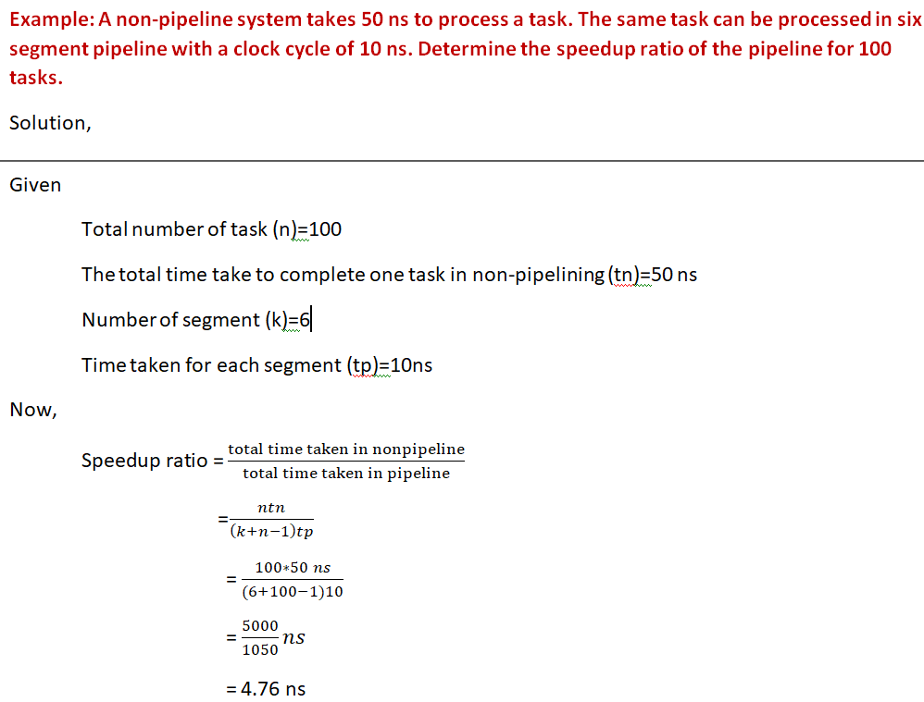
Pipelining

Slide 58
In 8086 pipelining is possible due to use of queue.
BIU fills in the queue until entire queue is full.
BIU restarts filling in the queue when at least two locations of queue are vacant.

